Slide 1
REST in peace
Notes:
https://www.slideshare.net/AhmadHafizIsmail/introduction-to-graphql-or-how-i-learned-to-stop-worrying-about-rest-apis

Slide 2
Agenda
What is GraphQL
Implementation options / runtime
Demo

Slide 3
What is GraphQL
A query language for your API developed by Facebook….
….and a runtime for executing queries
With GraphQL, you model your business domain as a graph
GraphQL services typically respond using JSON, however does not require it.

Slide 4
GraphQL: who is using it… to name a few?

Slide 5
GraphQL: as a replacement for REST?
With REST you could achieve (almost) the same as with GraphQL
Some of the challenges when building RESTful APIs
Under/over-fetching of data
Multiple round trips when aggregating data
No real standards (REST = architectural style)
Naming things

Slide 6
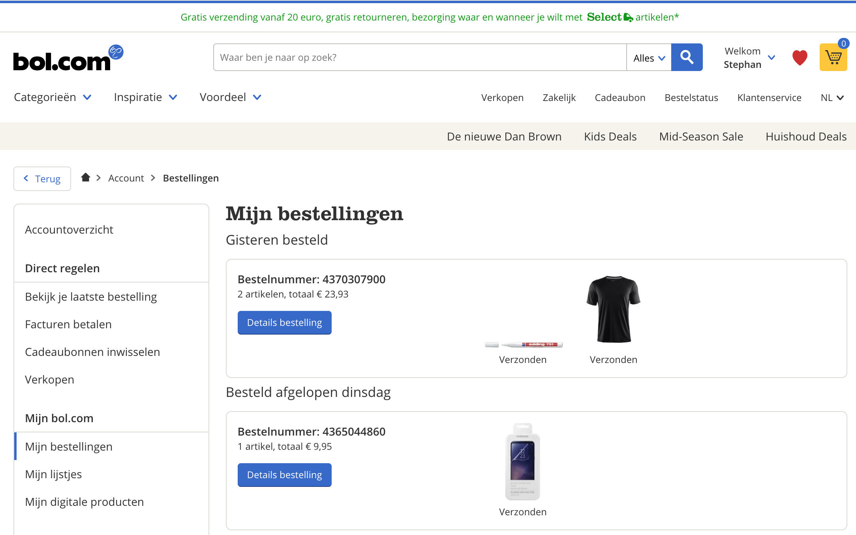
Consider this website…using REST (1)
GET /orders/4370307900
{ "totalPrice": "23.93",
// ... more fields }

Slide 7
The same website…using GraphQL
Query
{ order (id: 4370307900) { totalPrice } }
Result
{ "data": { "order": { "totalPrice": ”23.93" } } }

Slide 8
Consider this website…using REST (2)
GET /orders/4370307900
GET /shipments/345
GET /shipments/345
GET /products/123
GET /products/234
Notes:
Multiple REST calls needed to get all the data on the screen.
From multiple different services

Slide 9
With REST we can solve this!
Expand parameter (leads to over-fetching)
GET /orders/4370307900?expand=product,shipment
…or…
Fields parameter (yay!)
GET /orders/4370307900?fields=totalPrice,orderItems(product(imageUrl),shipment(status))

Slide 10
But…
No real standard for doing this (best-practice)
Lot of details you have to deal with as a developer!

Slide 11
The same website…using GraphQL
Query
{ order (id: 4370307900) { totalPrice orderItems { product { imageUrl } shipment { status } } } }
Result
{ "data": { "order": { "totalPrice": "23.93", "orderItems": [ { "product": { "imageUrl": "https://123.img" }, "shipment": { "status": "verzonden" } }, { "product": { "imageUrl": "https://234.img" }, "shipment": { "status": "verzonden" } } ] } } }

Slide 12
GraphQL schema definition options
You model your business domain as a graph
Different implementation options
Schema-first: GraphQL SDL/IDL
Code-first approach
Hybrid: SPQR (speaker)
Notes:
http://graphql.org/learn/thinking-in-graphs/

Slide 13
GraphQL schema: defines the types
schema { query: Query mutation: Mutation } type Query { … } type Mutation { … }
Notes:
Two ROOT types:
Query
Mutation

Slide 14
GraphQL type definition
Build in Scalar types:
Int: A signed 32‐bit integer.
Float: A signed double-precision floating-point value.
String: A UTF‐8 character sequence.
Boolean: true or false.
ID: The ID scalar type represents a unique identifier.
type TypeName { fieldName: FieldType }
Notes:
Special build in types

Slide 15
GraphQL type definition
Build in Scalar types:
Int: A signed 32‐bit integer.
Float: A signed double-precision floating-point value.
String: A UTF‐8 character sequence.
Boolean: true or false.
ID: The ID scalar type represents a unique identifier.
type Order { totalPrice: String, … }
Notes:
Special build in types

Slide 16
GraphQL types: model the shape of your data
type Order { totalPrice: String, orderItems: [OrderItem] }
type OrderItem { product: Product, shipment: Shipment }
type Product { imageUrl: String } type Shipment { status: String }
Notes:
Type
Fields
Fields are build in types
Or other types
Singular of plural []

Slide 17
GraphQL special type: Query
type Query { order(id: Long): Order }
type Order { totalPrice: String, orderItems: [OrderItem] }
{ order (id: 4370307900) { totalPrice orderItems { ...
} } }
Notes:
Special build in types

Slide 18
Agenda
What is GraphQL
Implementation options / runtime
Demo

Slide 19
GraphQL runtime
Runtime (and or server)
C# / .NET Clojure Elixir Erlang Go Groovy Java JavaScript PHP Python Scala Ruby
Client side tools
C# / .NET Go Java / Android JavaScript Swift / Objective-C iOS

Slide 20
GraphQL Java
graphql-java
graphql-java: core library for graphql query execution
graphql-java-servlet: servlet endpoint for GraphQL
graphql-java-tools: schema first library
graphql-spring-boot: Spring boot starter for GraphQL
But also...
GraphQL SPQR: code-first java library for Rapid GraphQL application development

Slide 21
GraphQL-java: code-first

Slide 22
GraphQL-java: schema-first

Slide 23
GraphQL-java-tools: schema-first

Slide 24
GraphQL: how do you execute a Query
You define a query, e.g. what shape of data do you need?
You execute it using the GraphQL runtime
You process the result

Slide 25
Tools
GraphiQL
https://github.com/APIs-guru/graphql-voyager

Slide 26
Agenda
What is GraphQL
Implementation options / runtime
Demo

Slide 27
Demo

Slide 28
Links
http://graphql.org/learn/
https://www.howtographql.com/
https://github.com/graphql-java/awesome-graphql-java
https://developers.facebook.com/docs/graph-api/using-graph-api

Slide 29
TODO
GraphQL: TODO
REST vs GraphQL
REST levels
Under/over-fetching
Expand
Fields parameter
Introspection is formalised (no swagger etc needed)
Type system
Build in (required) types
Custom Scalar types
Queries, mutations and subscriptions
Microservice vs aggregation service
GraphQL servlet vs custom endpoint

